Slide 1

FPT EDUCATION
Practices for KIT Arduino Uno R3
Version 1.0

Slide 2
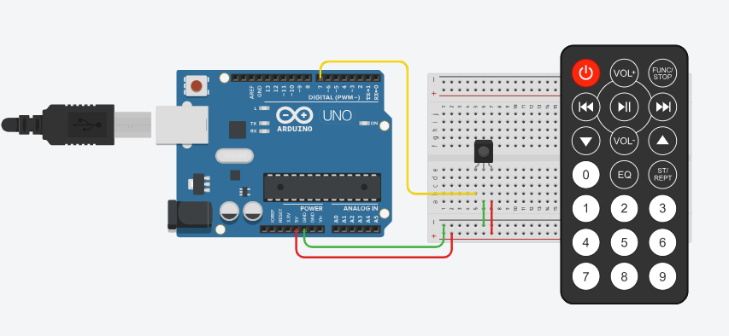
Lab#10: IR Remote

Slide 3
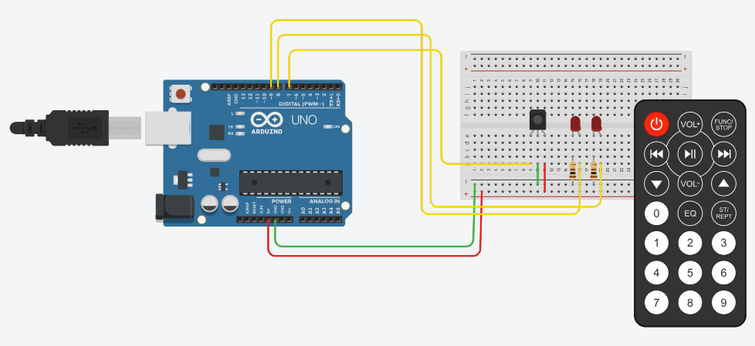
Lab#11: On/Off Device use IR Remote

Slide 4
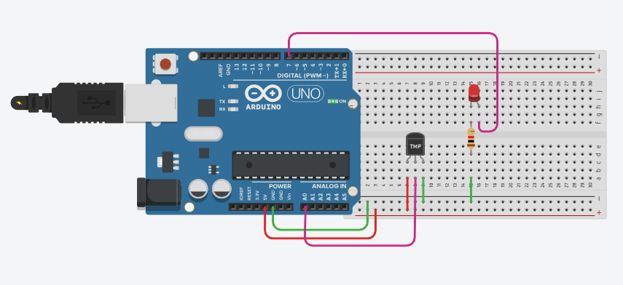
Lab#12: Temperature Sensor LM35/TMP

Slide 5
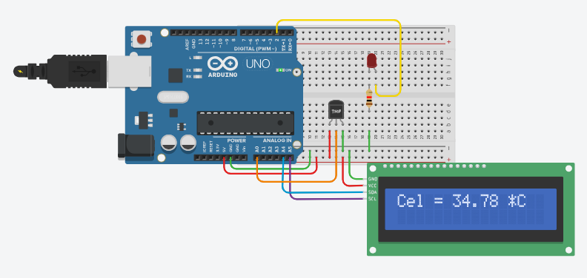
Lab#13: Sensor LM35/TMP And LCD1602

Slide 6
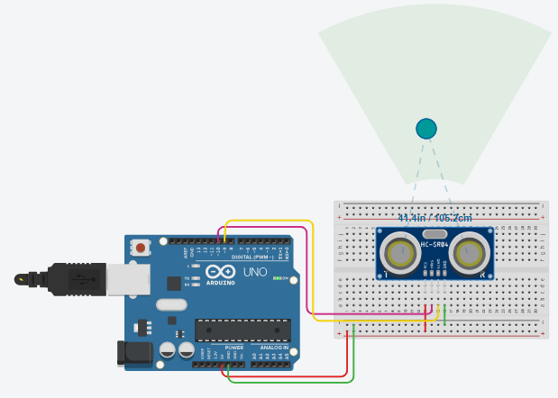
Lab#14: Ultrasonic Distance Sensor

Slide 7
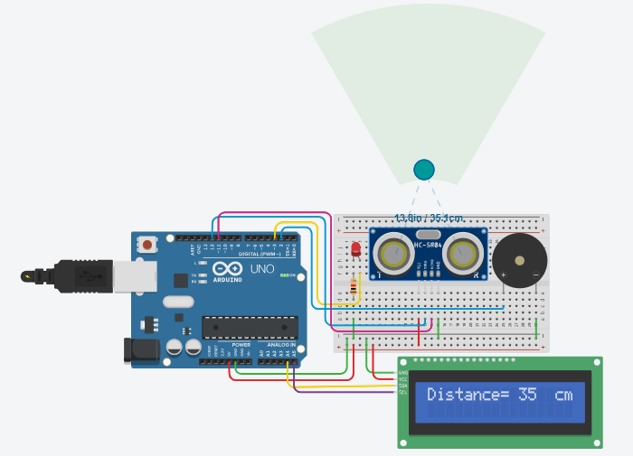
Lab#14: Ultrasonic Distance Sensor

Slide 8
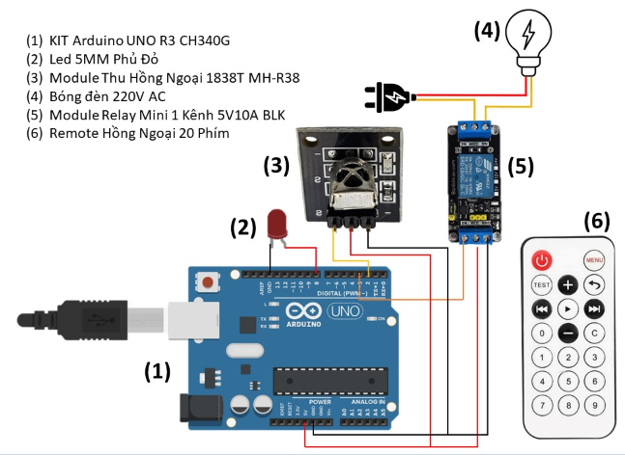
Applications

Slide 9
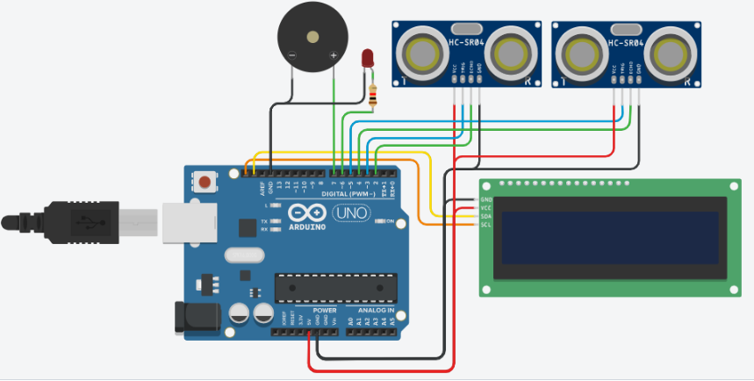
Applications

Slide 10
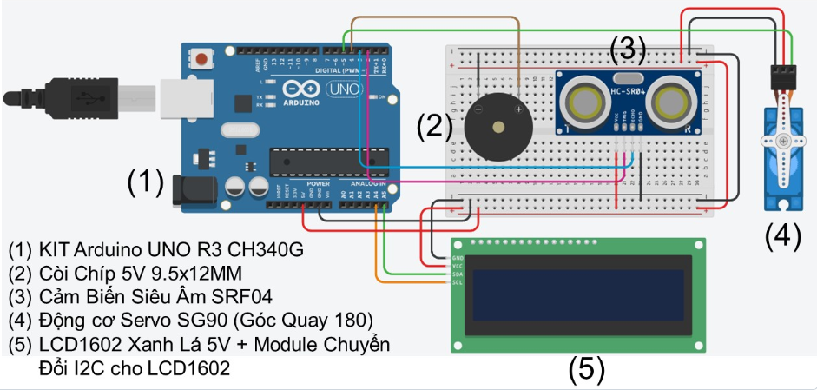
Applications

